Slide 1


BIG GAME DATA ANALYSIS

Slide 2

Introduction
The Big Game Census analyzes player data, including demographics, performance, and geographic details. It aims to uncover patterns, trends, and insights about players' profiles, such as birthplace, age, college, and team affiliations. By cleaning and visualizing this data, the census helps understand key aspects of player distribution and its impact on the game.

Slide 3

Details of Data
Player Details: Name, jersey number, position, age, weight, years played.
Geography: Birthplace (city/state), coordinates, population data.
Education: College attended.
Team Info: Team, conference.
Sources: Census links and state data.

Slide 4

Main KPIs
Player Demographics:
Average age, weight, and years played.
Geographic distribution of player birthplaces.
Team Representation:
Number of players per team and conference.
Player origins by state and city.
Educational Background:
Most represented colleges.
Population Insights:
Correlation between player birthplaces and city/state population data.

Slide 5
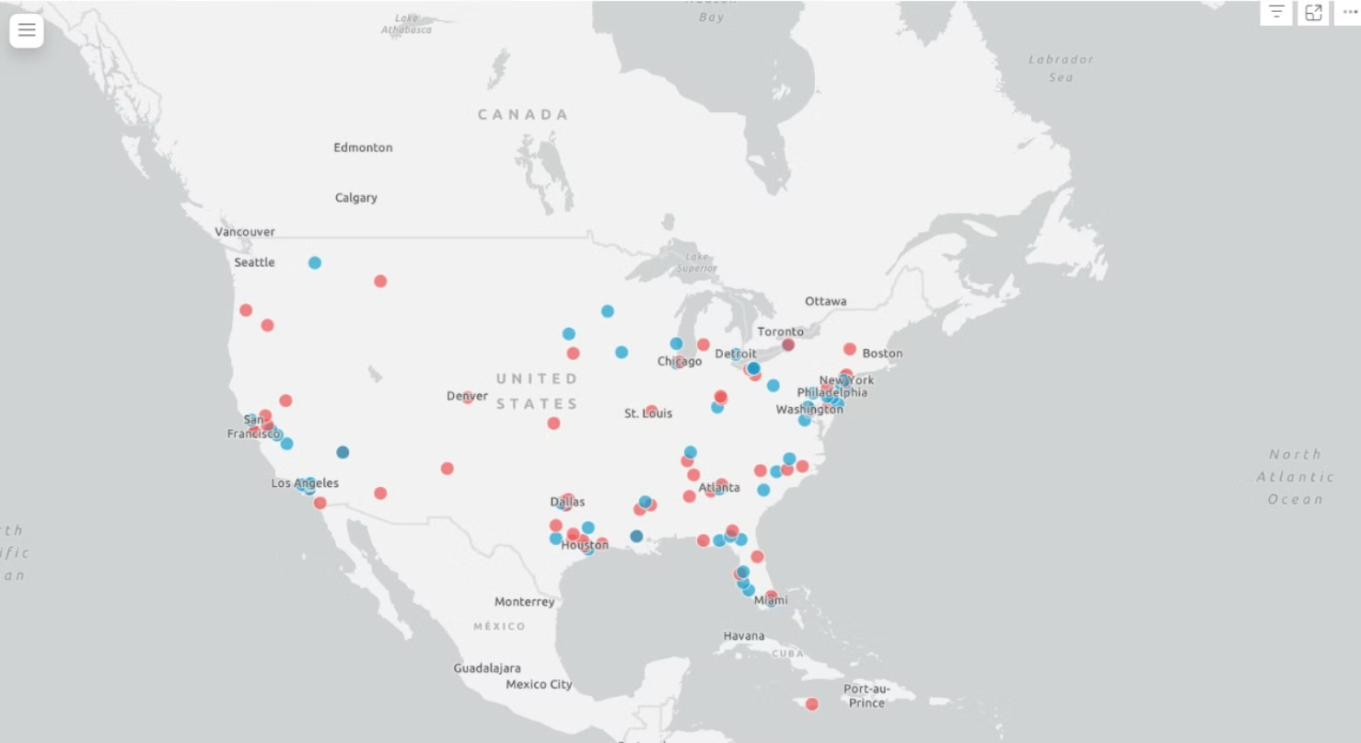
My Design

Slide 6
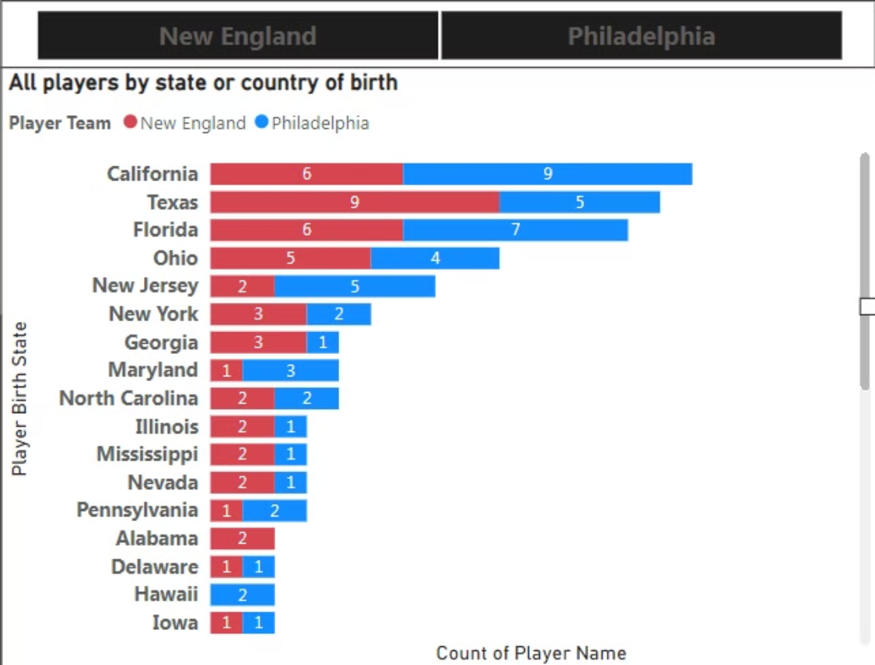

Slide 7
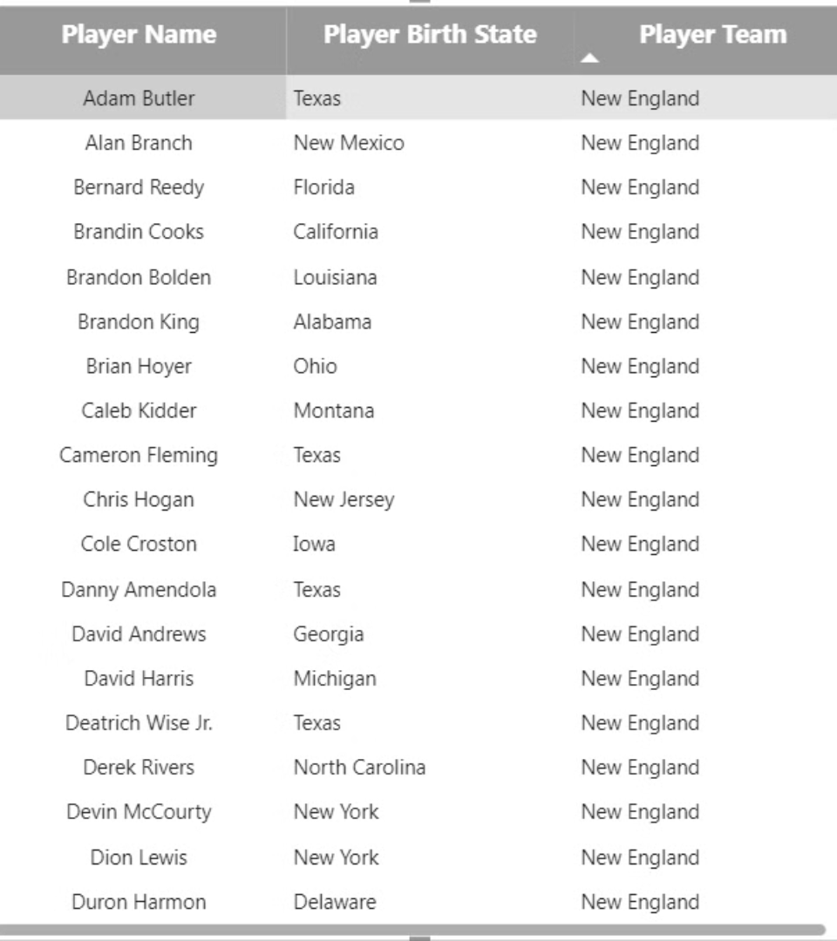

Slide 8

Analysis
1. Best Player of the year.
2. Overall best player.
3. Tallest Player.
4. Shortest Player.
5. Player with most basket.
6. Top 5 best players
7. Player with highest agility

